Slide 1
Team RED
CS1:Task09

Slide 2

Live Demo

Slide 3

Architecture

Slide 4

Billing

Slide 5

Layout & Navigation

Slide 6
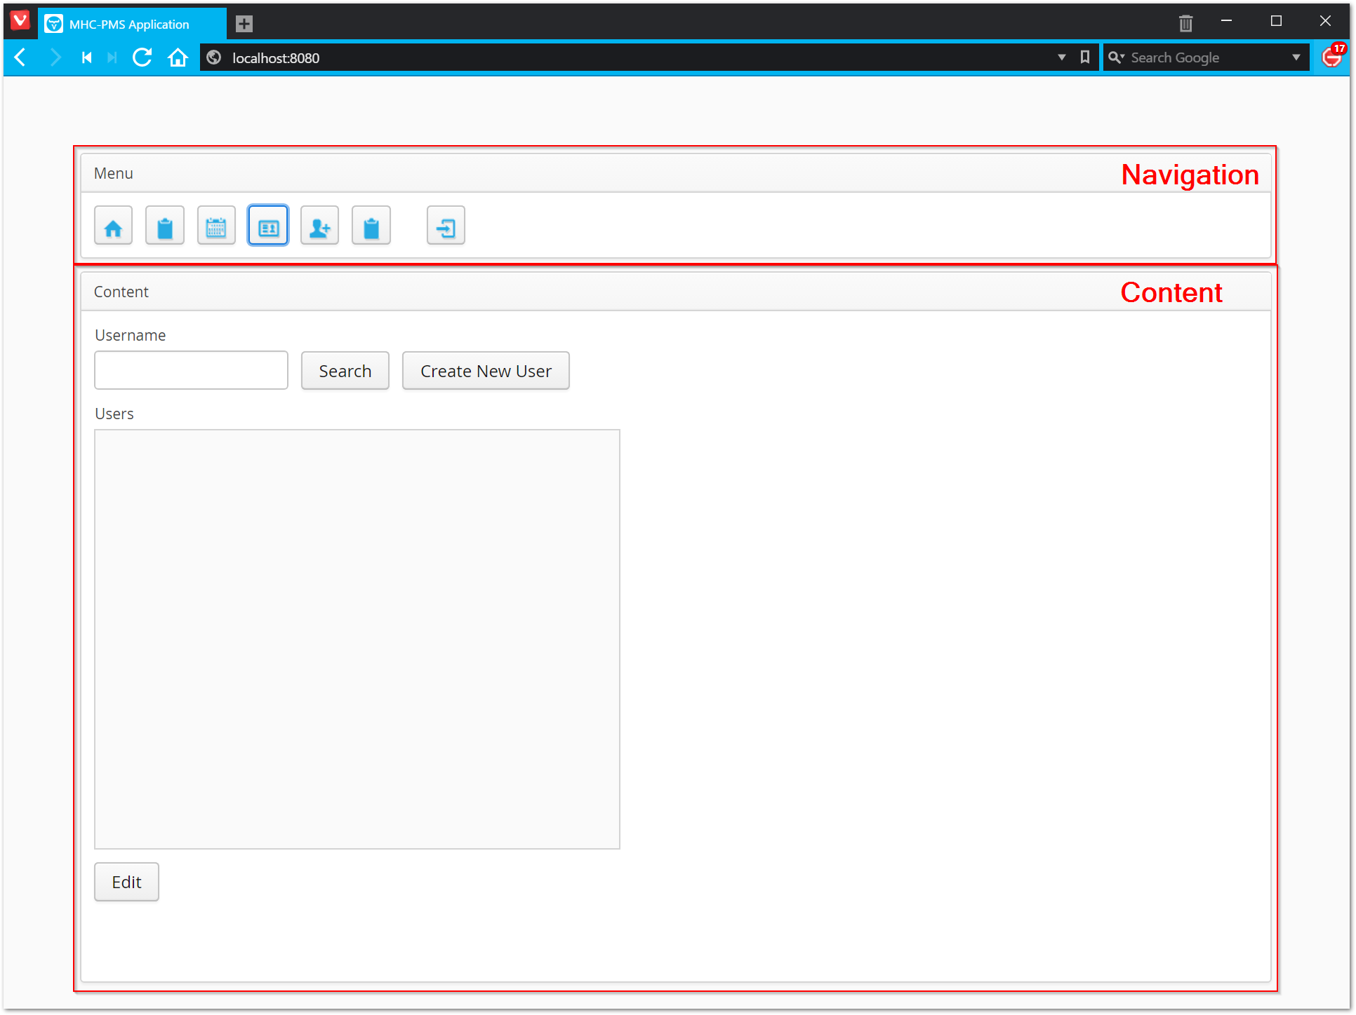
Layout

Slide 7

User Management

Slide 8

Personal contributions

Slide 9


Slide 10

Lessons Learns

Slide 11

Scrum

Slide 12
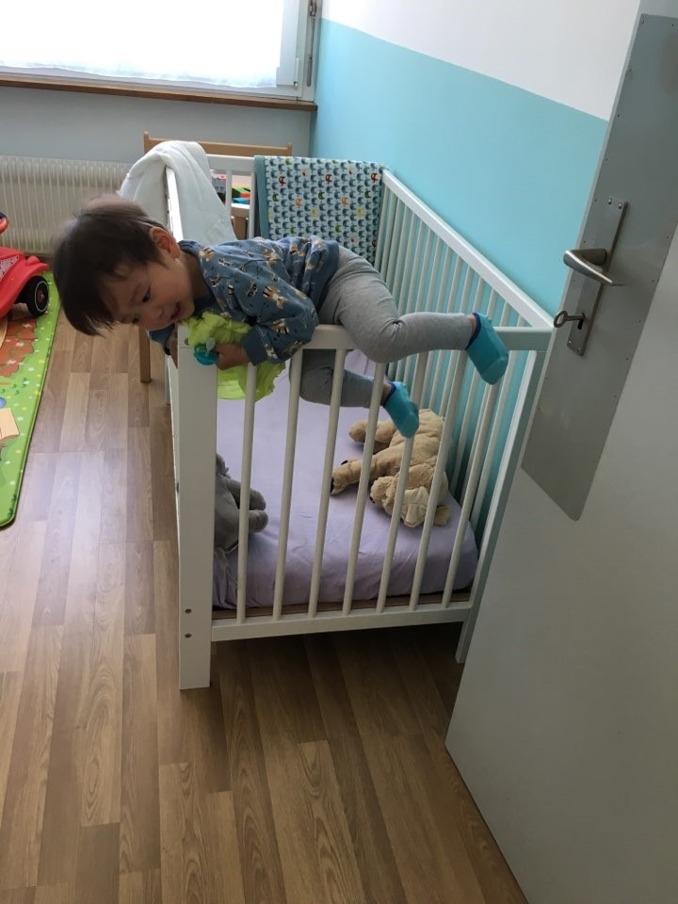
Never give up and
never surrender

Slide 13

?

